Slide 1
EMG-Based Classification of Hand Movement in Virtual and Physical Reality
Dailyn Despradel, Luigi Burda, and James Wong
24-787 Final Project Presentation
December 8th, 2022
Notes:
Main title: 40 pt. Arial
Presenter Name: 16 pt. Arial
Presenters Title: 16 pt. Arial Italic

Slide 2

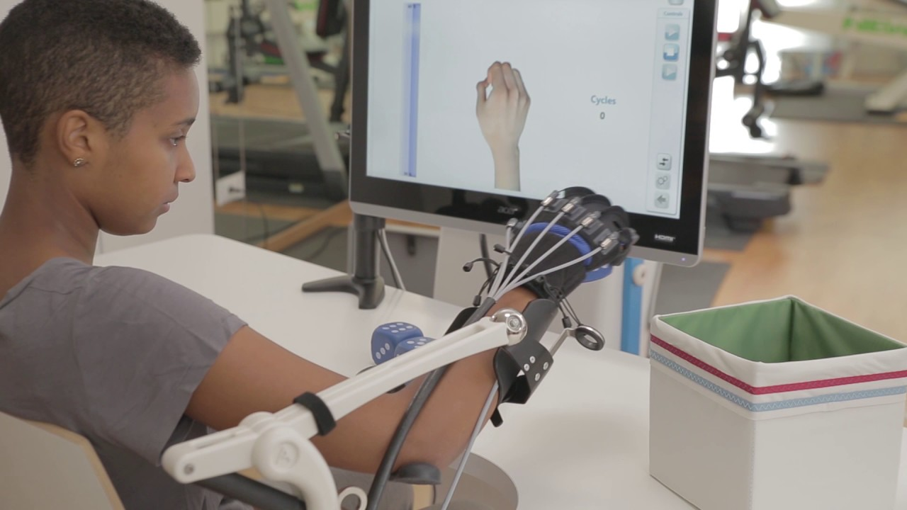
Background
Classification of electromyography (EMG) allows for personalized rehabilitation training that could enhance motor performance
Physical Environment
Virtual Environment
Goal: Our project proposes the use of machine learning (ML) to select a classifier that best discriminates EMG patterns of a set of muscles while performing grasping movements within a virtual and physical environment.

Slide 3
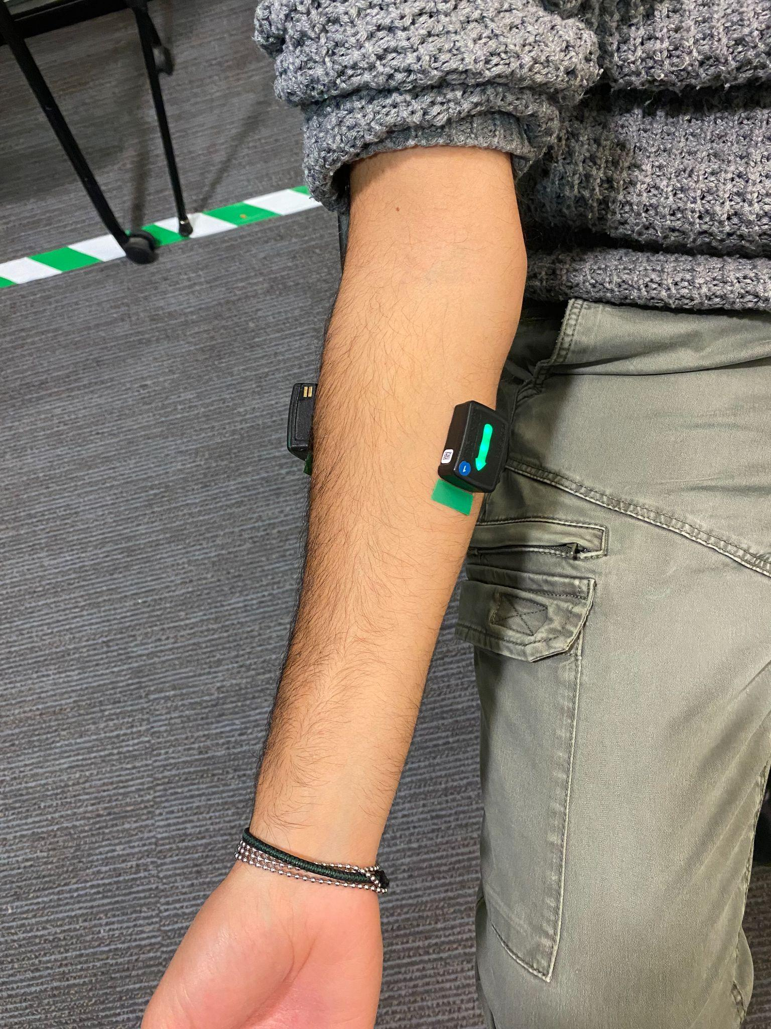
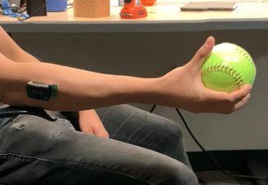
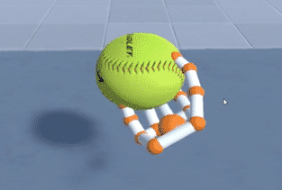
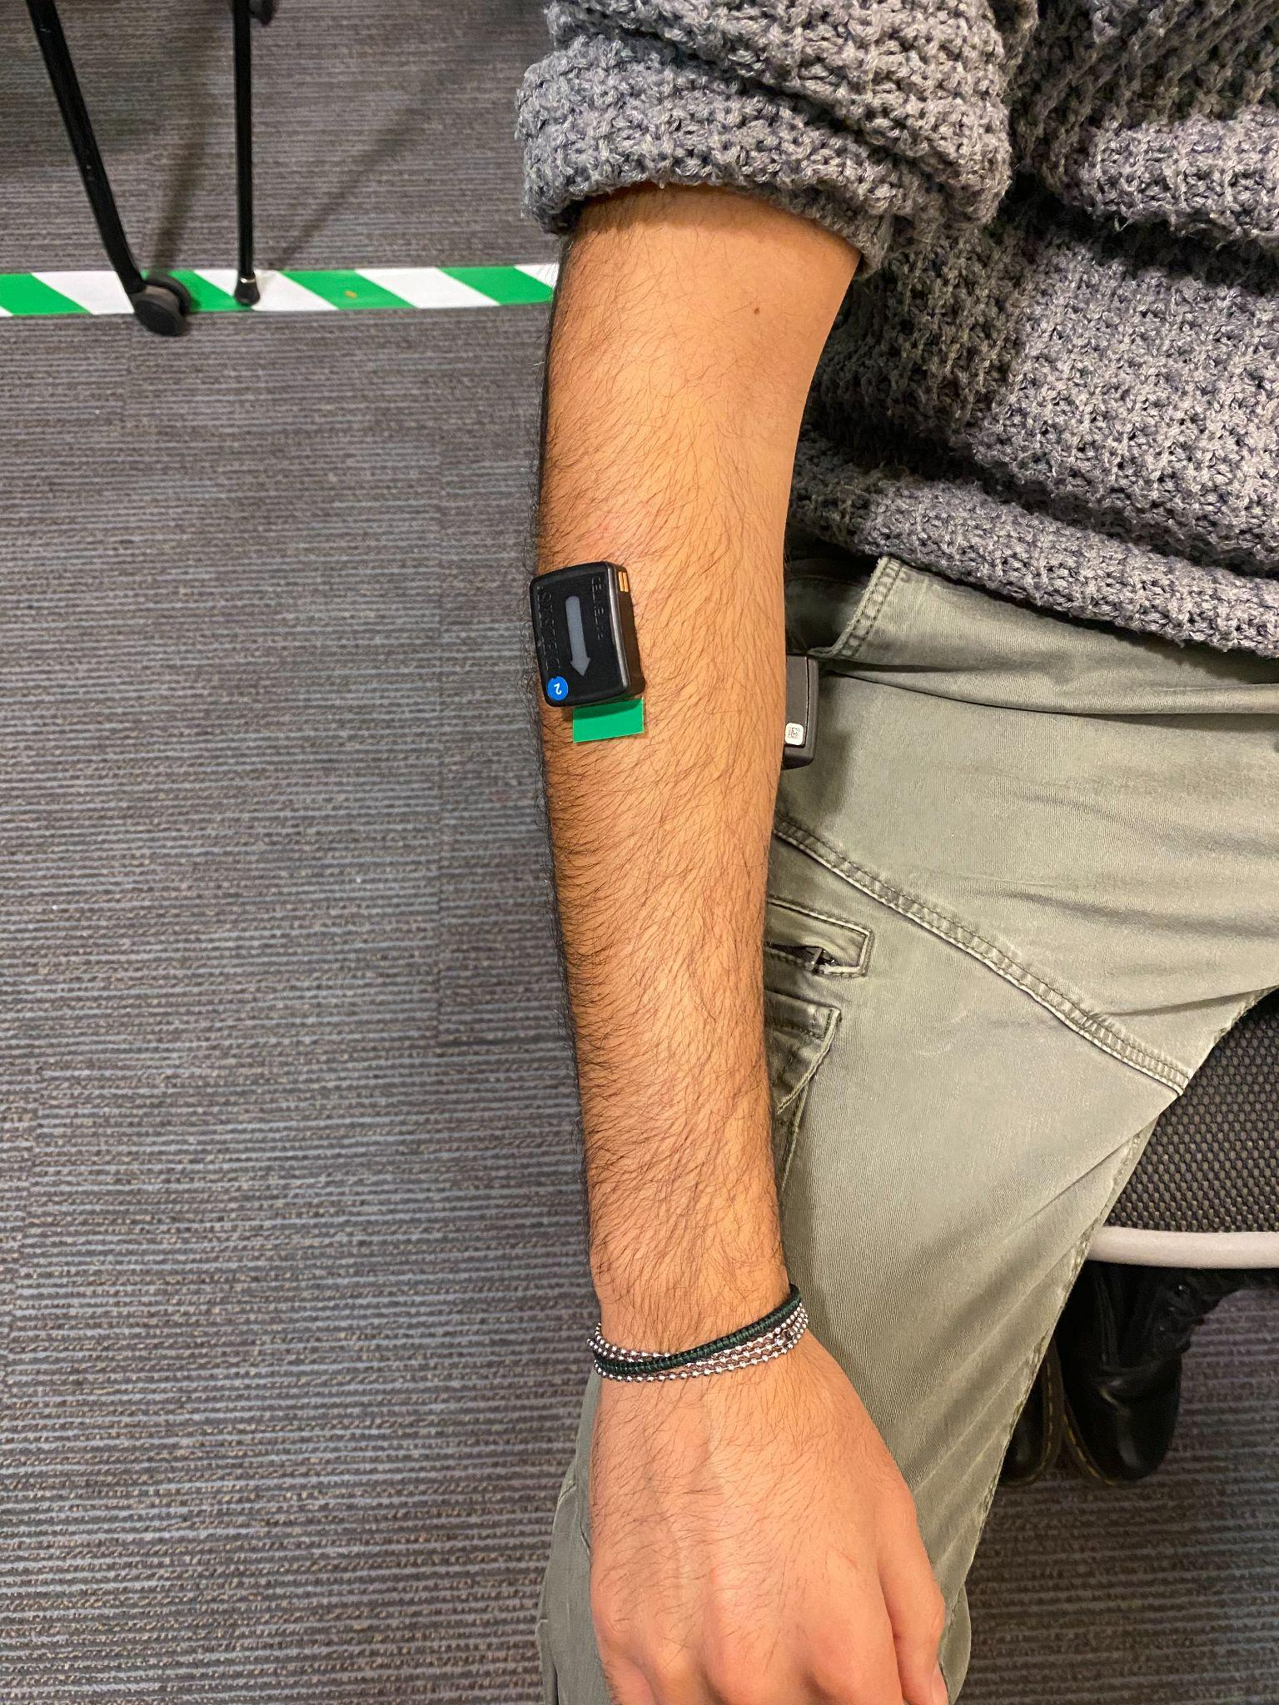
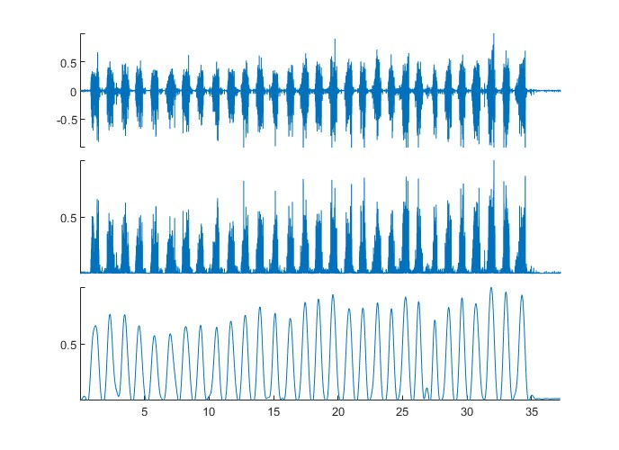
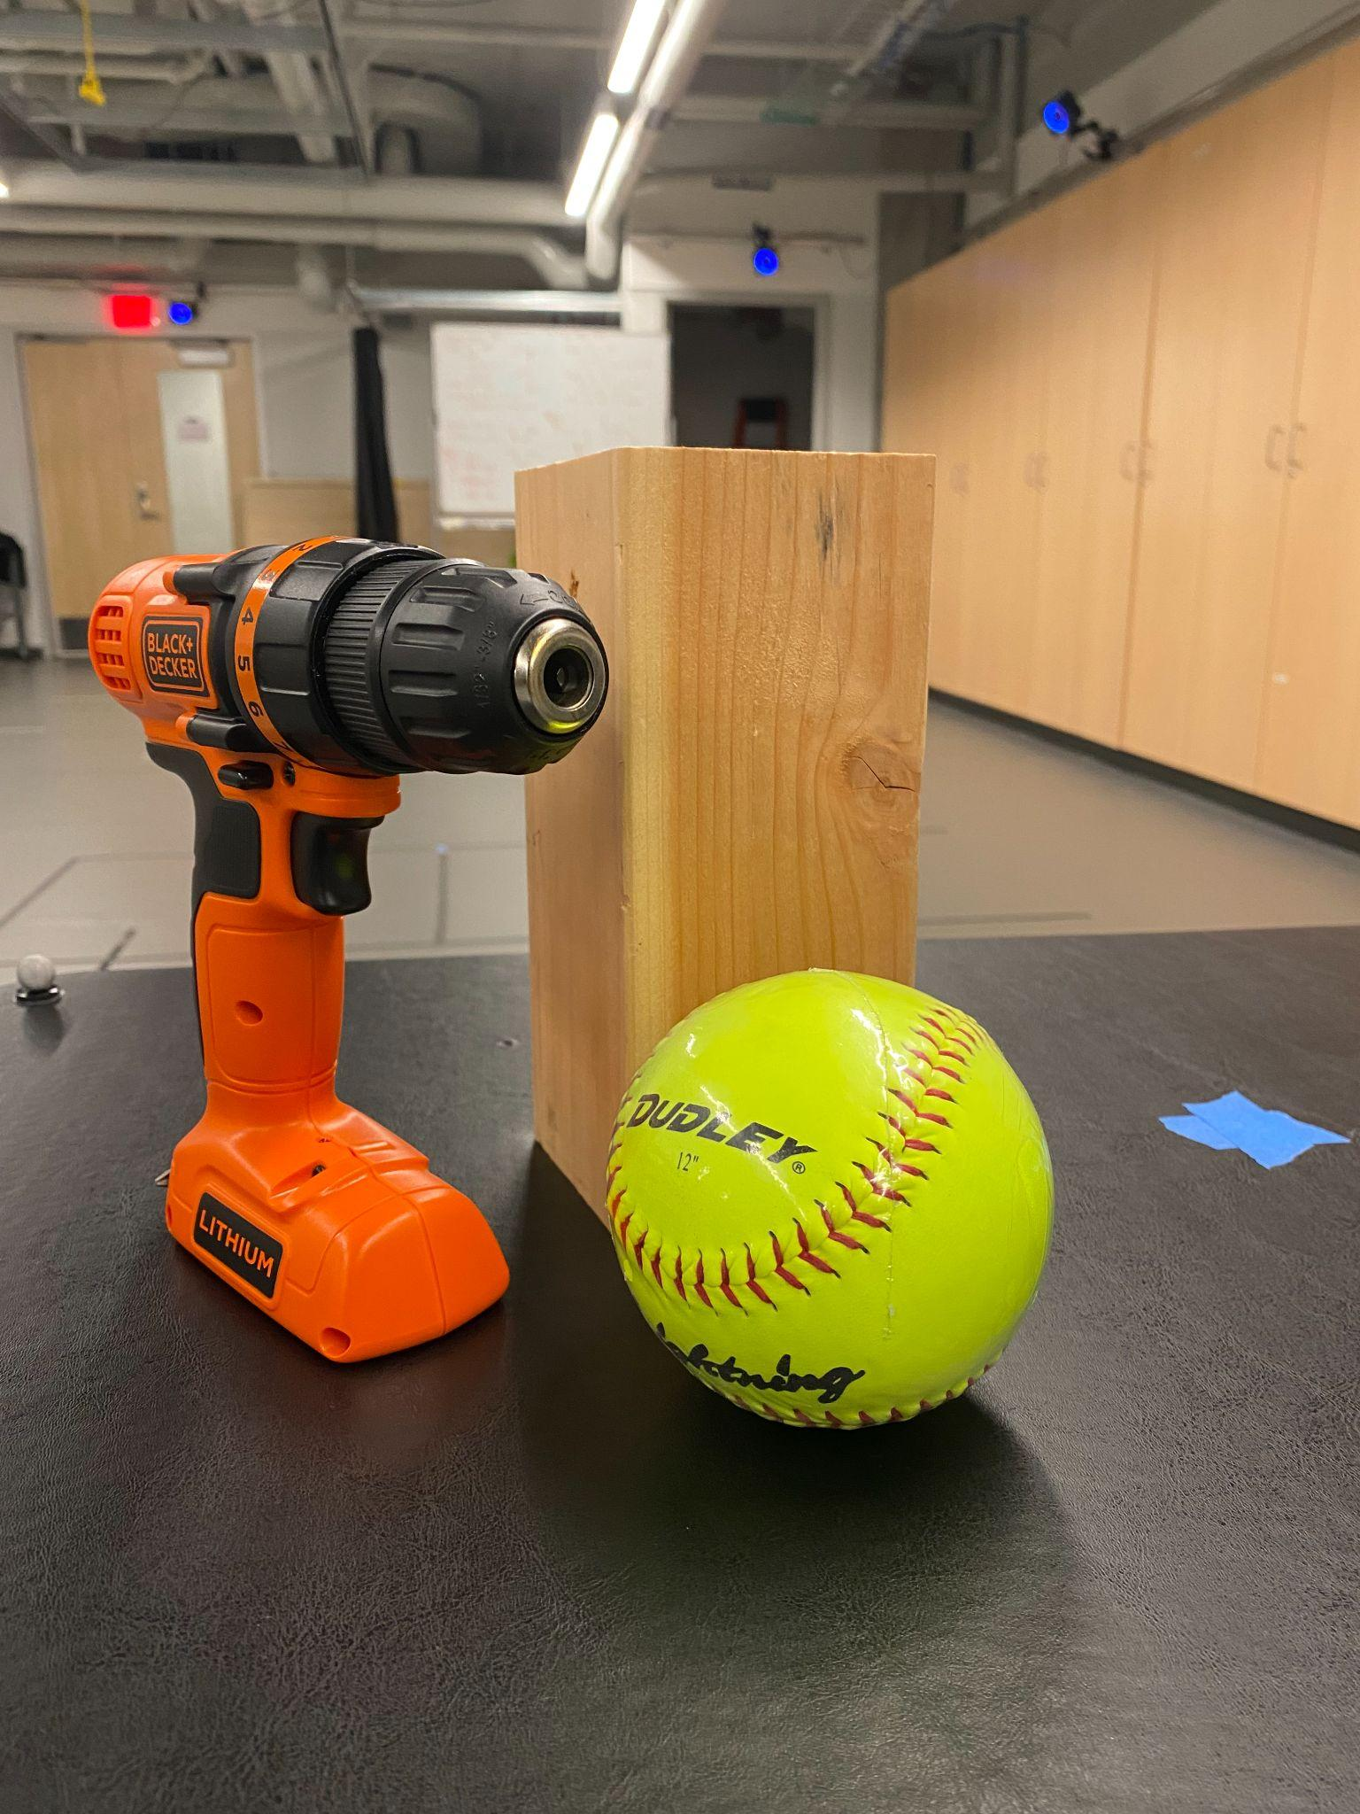
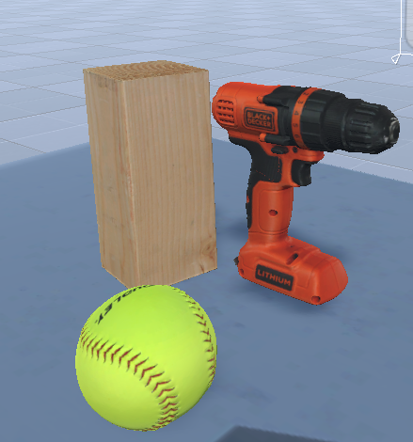

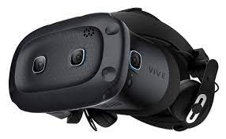
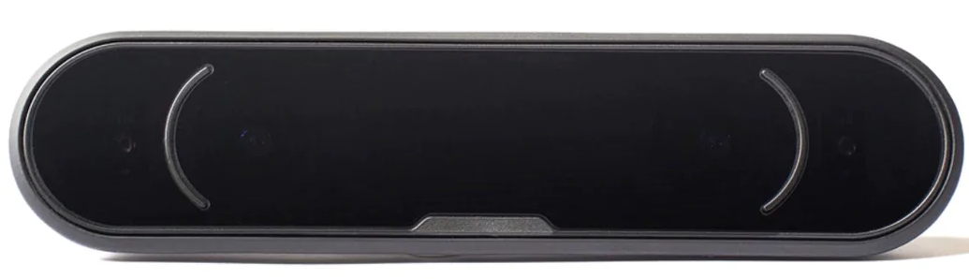
Workflow
4.
Experimental Task
1.
Muscle Selection:
3.
Maximum Voluntary Contraction (MVC)
ECR
Contraction
2s
FCU
3s
3s
Rest
Rest
FCU = Flexor Carpi Ulnaris
ECR = Extensor Carpi Radialis
5.
EMG Signal Processing
2.
Objects and Environments
1
Normalized EMG
Raw signal
-1
1
Normalized EMG
Band-pass
35-400 Hz
-1
1
Normalized EMG
Low-pass
2 Hz
HTC Vive
Leap Tracker
-1
Time(s)

Slide 4
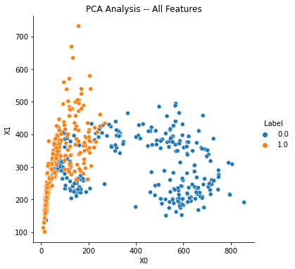
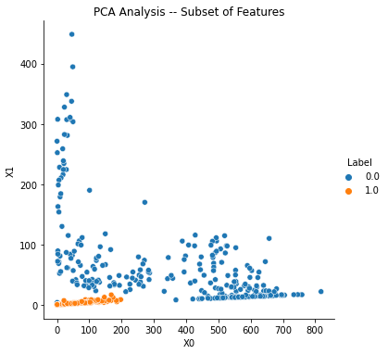
Model Overview
Featurization
Features and Algorithms
For each muscle:
zero crossing count (ZC)
slope sign change count (SSC)
waveform length (WL)
Willison amplitude (WA)
Variance (Var)
Skewness (Skew)
Kurtosis (Kur)
Mean (Mean)
standard deviation (SD)
Most Important Features
SSC_ECR
WA_FCU
WL_ECR
WL_FCU
SD_ECR
SD_FCU
Mean_ECR
Mean_FCU
Var_FCU
Algorithms
K-Nearest Neighbor (KNN)
Support-Vector Machine (SVM)
Logistic Regression
Random Forest
Gradient Boosting
Naive Bayes
Sapsanis, C., Georgoulas, G. & Tzes, A. EMG based classification of basic hand movements based on time-frequency features. 722 (2013). doi:10.1109/MED.2013.6608802.

Slide 5
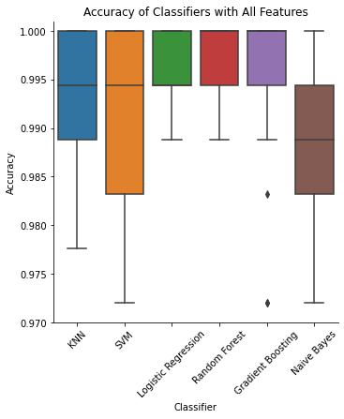
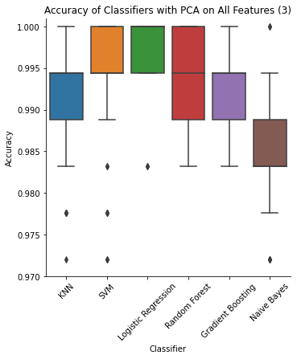
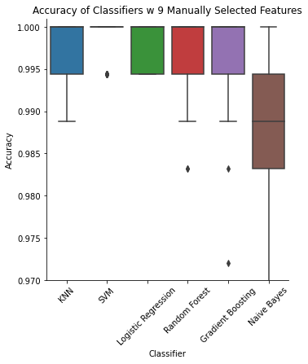
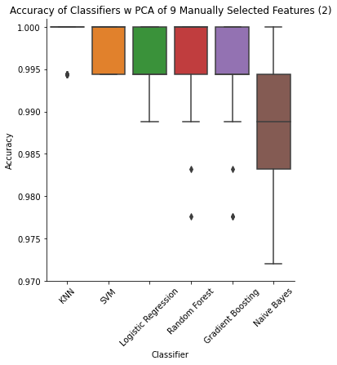
Results
Algorithm Performance
Conclusion
There is a substantial difference between emg signals in the real and virtual environments
All the tested classifiers showed an accuracy on the test set higher than 97% in classifying the two environments
Features selection improved the overall performances of the classifiers
Naive Bayes showed the worst performances
Logistic regression, random forest and gradient boosting showed a consistent high accuracy and low standard deviation
Given its computation efficiency we would choose logistic regression

